Slide 1
ETHICAL HACKING INTERNSHIP

Slide 2
Task 2:
Explore the website and try to find vulnerabilities in the website and report it to us.
http://testasp.vulnweb.com/

Slide 3
TITLE - CROSS SITE SCRIPTING
Domain - Vulweb.com
Subdomain – testasp.vulnweb.com

Slide 4
Steps to Reproduce:

Slide 5
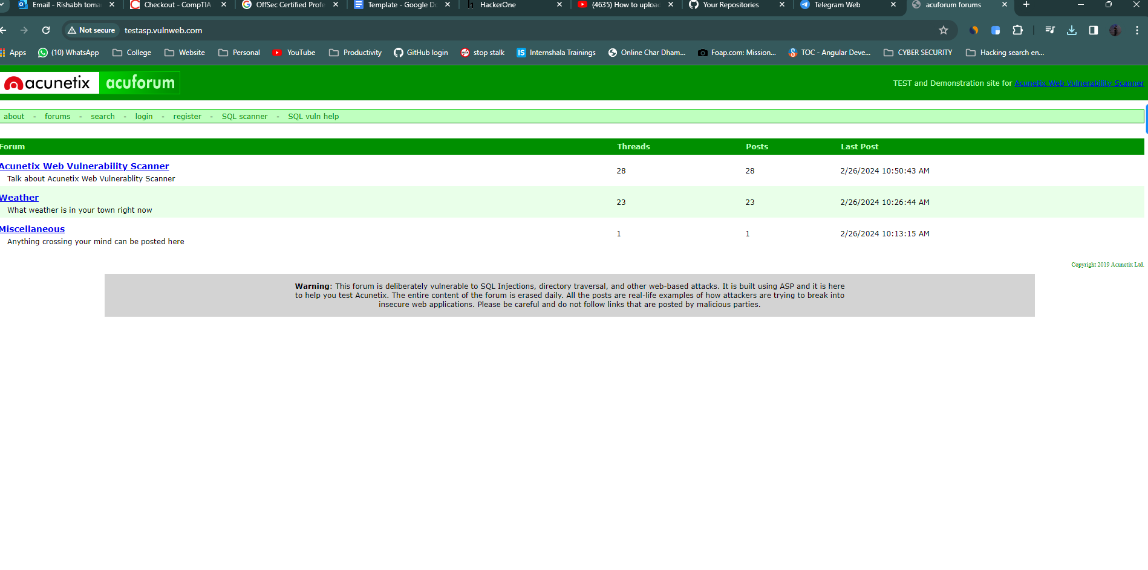
Step 1: Visit http://testasp.vulnweb.com/

Slide 6
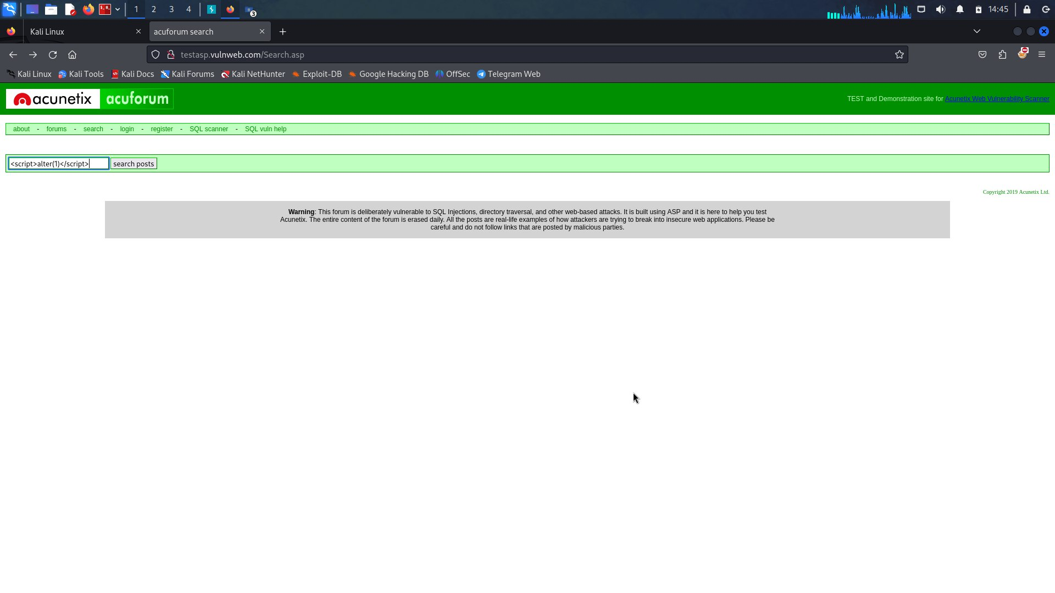
Step 2: on the top menu you will find a search option.
Step 3: Click on it and you will be prompted with the search box.
<script>alter(1)</script>

Slide 7
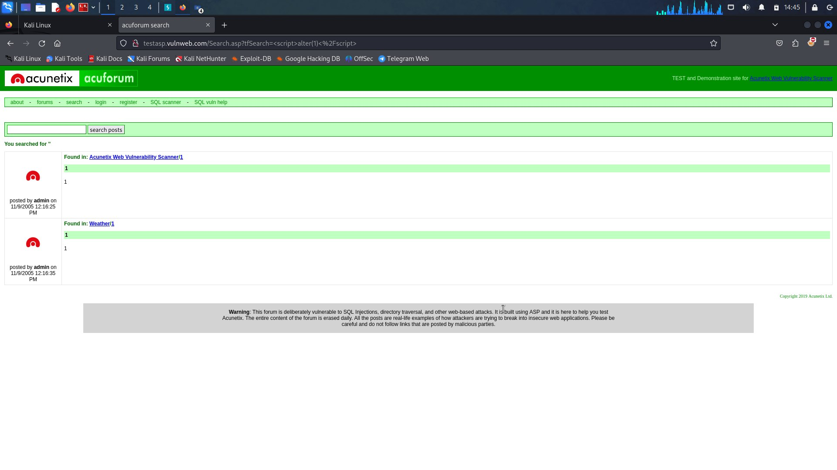
Step 4: You can Intercept the request in burp suite.

Slide 8
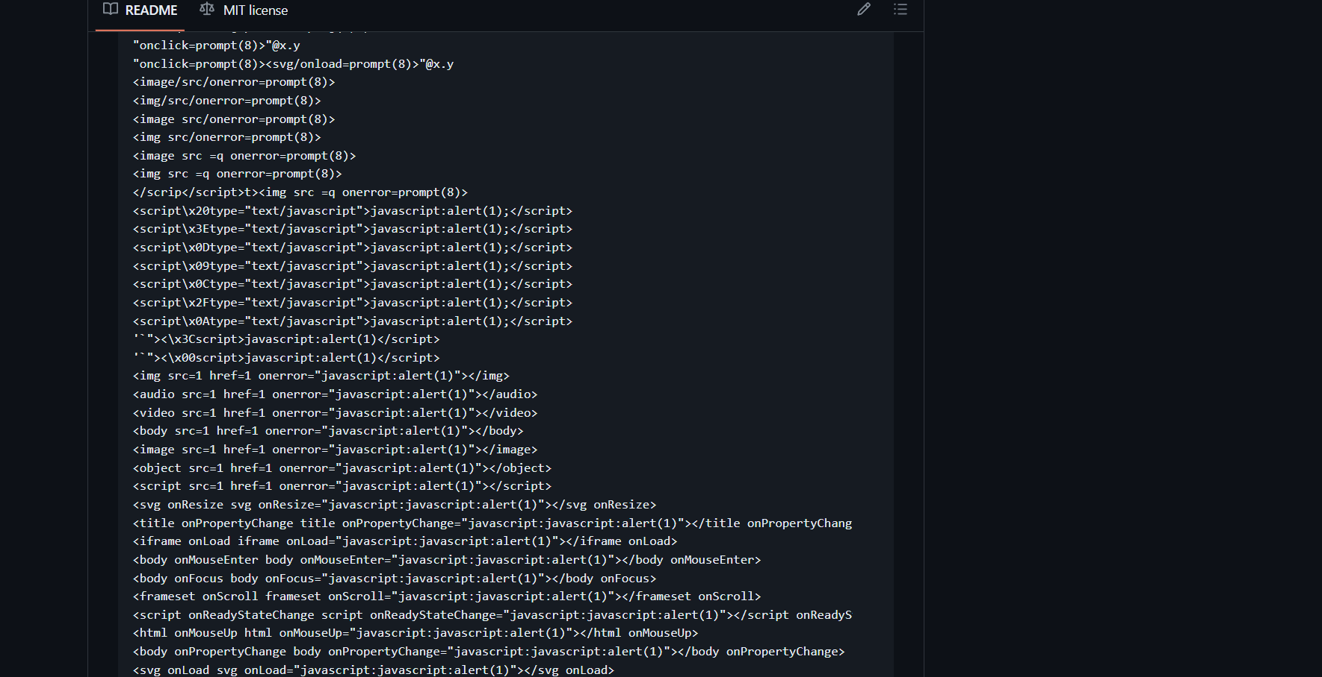
Step 5: Now you can find different payloads.

Slide 9
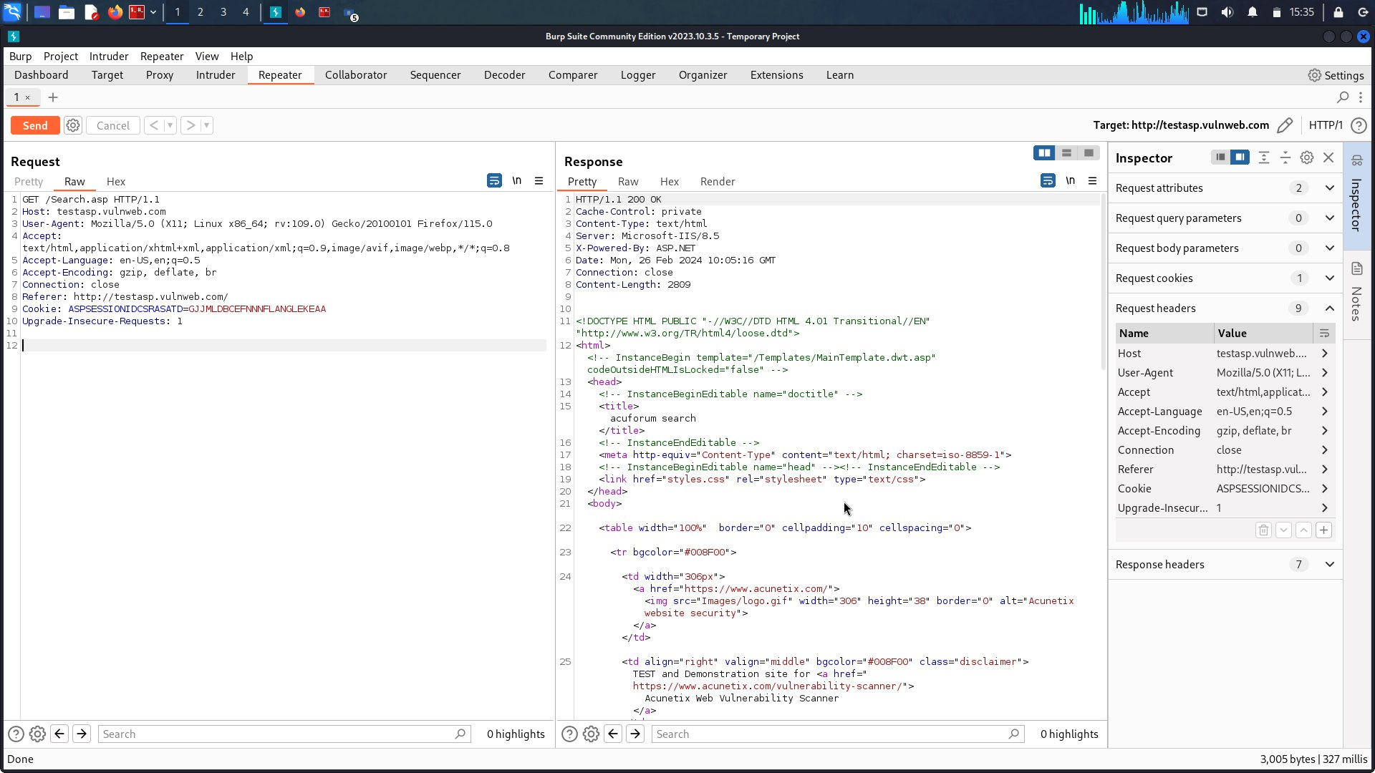
Step 6: Send the request to intruder and paste all payloads.
Step 7: Try to find a successful payload for xss.

Slide 10
Thank you

